Slide 1
UNIT-2
FUNDAMENTALS OF MARKETING AND HRM
BY- PROF. TANVI BAGGA

Slide 2
WHAT IS MARKETING?
Marketing refers to any actions a company takes to attract an audience to the company's product or services through high-quality messaging. Marketing aims to deliver standalone value for prospects and consumers through content, with the long-term goal of demonstrating product value, strengthening brand loyalty, and ultimately increasing sales.

Slide 3
According to the American Marketing Association (AMA), marketing is “the performance of business activities that direct the flow of goods and services from producer to consumer or user.”
As per Philip Kotler, “Marketing is a social and managerial process by which individuals and groups obtain what they need and want through creating and exchanging products and value with other.”

Slide 4
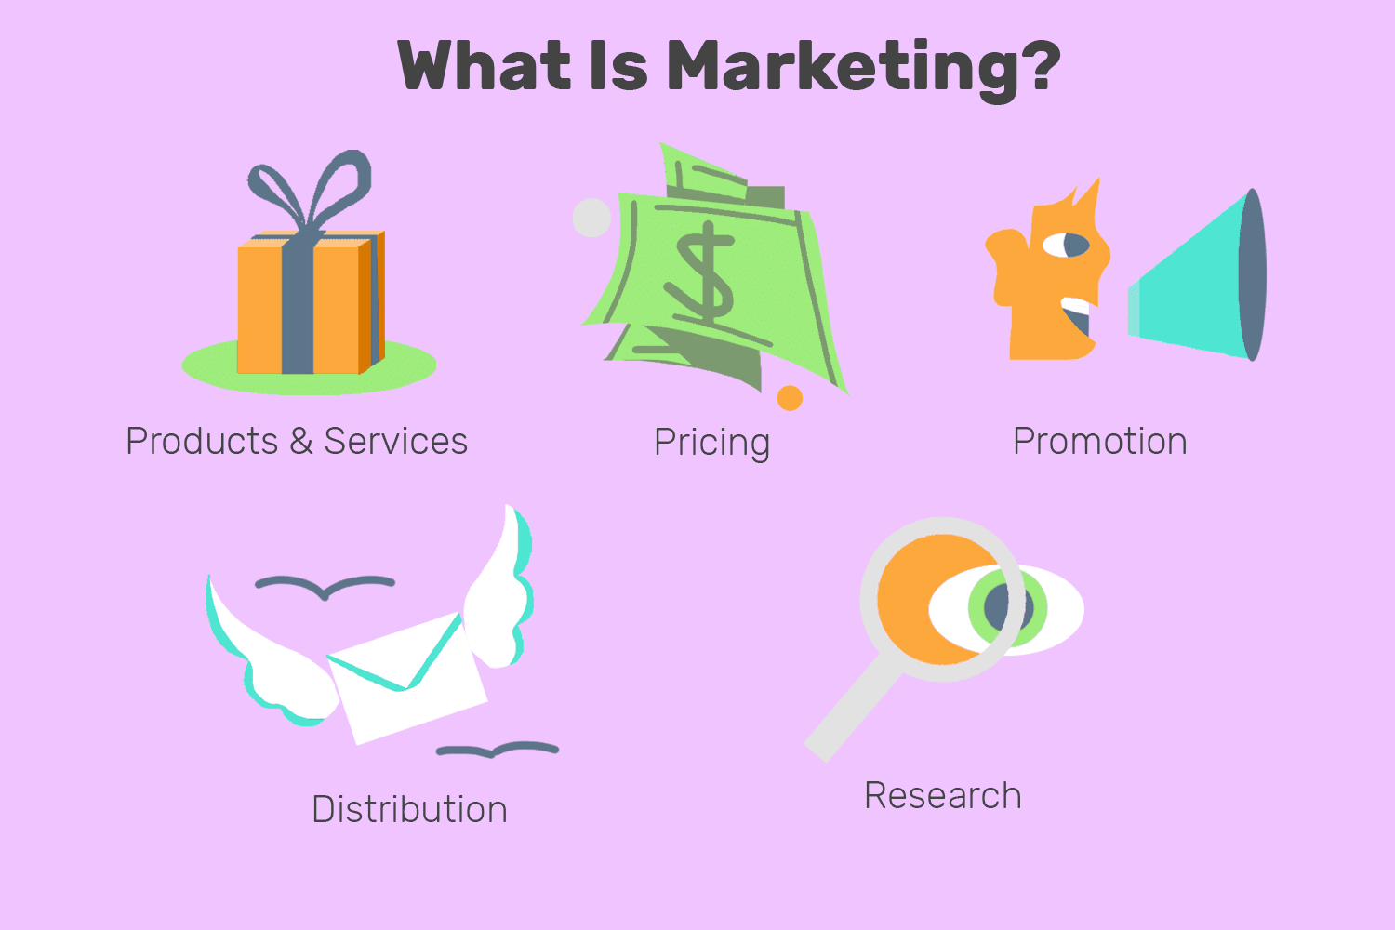


Slide 5
IMPORTANCE OF MARKETING
1.Effective consumer engagement: Businesses must engage customers, and herein, marketing proves to be an effective tool. Customers can be engaged by telling them what they do not know and creating good content around your products and services.
2.Building and maintaining reputation: The reputation of your business depends on how it grows and what its lifespan is. This is where marketing comes across as a way to build the brand equity of businesses. And this happens when the expectations of the customers are met.

Slide 6
3.Building relationships between customers and business: For any business to grow, it must build a long-lasting relationship with its customers. Marketing is based on demographics, psychographics, and consumer behaviour and therefore, gives an understanding of what customers want.
4.Boosting sales: Since marketing utilizes different ways to promote products or services, it helps in increasing the likelihood of better sales. Happy customers translate into a company’s brand ambassadors automatically.

Slide 7
5.Staying relevant: Marketing helps a business to remain relevant to the customers and in its domain. It helps in maintaining good relationships.
6.Making informed decisions: The basic questions that every business has are around the how’s and why’s of producing products or delivering services. This underscores the importance of marketing for businesses and the fact that it links a business and society.

Slide 8
FEATURES OF MARKETING
1.It is an exchange process Marketing is an exchange process that involves the transfer of goods, services and ideas from one person to the other in return of some monetary value. Different functions of marketing like distribution, after-sales services and packaging facilitate the exchange process.
2.It is a consumer-driven approach a consumer is the focal point of all marketing activities. Marketing attempts to satisfy consumer needs to retain the market demand for an organisation’s products. The process of marketing starts with identifying the needs of consumers and then planning the product that satisfies those needs.

Slide 9
3.It is a continuous activity -Marketing is a continuous process in the sense that it endlessly monitors the scope of innovation in the business environment. It is a never-ending process that includes developing and improving products and formulating various strategies such as pricing strategies, distribution strategies and promotional strategies.
4.It is an integrated approach-Marketing involves the coordination of several interrelated activities with the aim of delivering value to consumers. For example, marketing involves promotional measures to make consumers aware of the availability of a product, its features, etc.

Slide 10
SCOPE OF MARKETING
Market Research: Researching consumer demands and consumer behaviour.
Product Planning and Development: Planning and developing the offering according to what’s needed in the market.
Product Pricing: Pricing the offering according to the product value and the buyer’s paying capacity to maximise profits
Distribution: Distributing the offering, so it is available wherever and whenever the customer demands it.
Promotion: Communicating the right message that results in demand creation.
Sales: Offering incentives that increase sales.
After-Sales: Providing after-sales support to the customer to maintain a good brand image in the market.

Slide 11
CORE CONCEPTS OF MARKETING
The core concept of marketing is a social and managerial process by which individuals or firms obtain what they need or want through creating, offering, exchanging products of value with each other.
1.NEEDS- Needs are the basic requirements which human beings require for existence. These mainly consist of air, water, food, clothing and shelter. Along with these needs, some other needs which are required to be satisfied are education, medical care, entertainment, and recreation. It is a difficult task for a marketer to identify the needs of the customers since costumers may not be conscious of their needs, and even if they are, then they might be unable to put forth their needs clearly.

Slide 12

2.WANTS-The wants are a step ahead of needs and are largely dependent on the human needs. A need becomes a want when a need is directed to a specified object. Wants are designed according to the taste and preferences of the society.
Needs already exists in the market; however, wants may be created by the marketers. It can also be said that Need and Want are relative terms because a product may be considered to be a need by someone but it may also be perceived as a want by others. E.g. To have a food is a basic need of human beings but to have biscuits for food is a want created by the marketers.

Slide 13


3.DEMAND- A demand is generated when a customer is willing to buy a particular product and has an ability to pay for it. A company should study not only how many people want their product but also how many would actually afford to buy the product. E.g. Many people would be desirous to buy Ferrari car; however, there is only a small segment which can afford to buy it which reflects the demand for Ferrari car in the market.
Demand = Willingness to pay + Ability to pay

Slide 14

4.EXCHANGE- It is act of obtaining an object which one needs from another by offering some other thing in return. Marketing occurs when individuals decide to satisfy needs and wants through exchange. Marketing helps to create a business environment where exchange of value can take place.

Slide 15
For an exchange to happen:
(i) There should be at least two parties involved for any kind of exchange.
(ii) Each party must have something or other that interests the other party.
(iii) Each party must be willing to have an exchange with other party and must have a desirable or atleast acceptable opinion about the other party.
(iv) Each party must be totally free from any obligation regarding accepting or denying the offer.
(v) Each party must be able to communicate and deliver the product as per the requirement of the other.

Slide 16

5. CUSTOMER SATISFACTION- Satisfaction reflects a person’s judgment of product’s perceived performance in relationship to expectations. Customer satisfaction with a purchase depends on how well the product’s performance lives up to the customer’s expectations.
(i) If the performance falls short of expectations, the customer is dissatisfied.
(ii) If it matches expectations, then the customer is satisfied.

Slide 17
Performance < Expectation → Dissatisfied Customer
Performance = Expectations → Satisfied Customer
Satisfied customers will buy the product repeatedly and recommend the same to others; however, dissatisfied customers may switch to the competitors and discourage others to buy the product. Marketers should be careful while setting the expectations. If they set expectations too low, they may satisfy those who buy but fail to attract enough customers. If they raise expectations too high, customer might be disappointed.

Slide 18
6.CUSTOMER VALUE- Value reflects the sum of the perceived tangible and intangible benefits and costs to customers.
A product or services is successful when it delivers value and satisfaction to the buyers. Value is usually a combination of quality, service, and price.
Value changes based on time, place, and people in relation to changing environmental factors. It is a creative energy exchange between people and organizations in our marketplace.
Companies try to figure out the list of add-on benefits that they can provide based on the taste and preferences of the customers. A high value product not only helps the company to generate new customers but also helps to retain the older ones. Eg. Online parcel tracking facility provided by the courier companies without any additional cost can be one of the best examples of customer value. The same goes for free delivery of products purchased through online shopping portals.

Slide 19

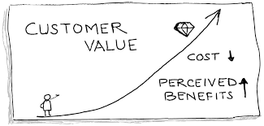

Slide 20
FUNCTIONS OF MARKETING
Promotion and Advertising: Promoting products or services to target audiences through various channels like advertising, social media, and public relations.
Distribution and Sales: Managing how products or services reach customers, including selecting distribution channels and sales tactics.
Customer Relationship Management (CRM): Building and maintaining strong relationships with customers to ensure satisfaction and loyalty.
Market Expansion: Identifying opportunities for growth, whether through entering new markets, expanding product lines, or diversifying
Measuring and Analyzing: Tracking the effectiveness of marketing campaigns and adjusting strategies based on data and feedback.
Ethical Considerations: Ensuring marketing practices are ethical and align with legal and societal standards.

Slide 21
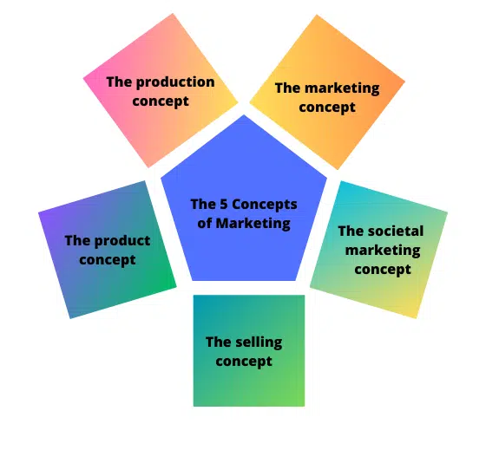
CONCEPTS/ORIENTATIONS OF MARKETING
The term “concepts of marketing” refers to a broad term that includes various approaches or philosophies utilized to promote a product or service.
These concepts serve as fundamental principles guiding the marketing process. They form the basis for developing strategies and tactics to achieve marketing goals.
5 CONCEPTS OF MARKETING ARE AS FOLLOWS-

Slide 22
1. The Production Concept
The production concept suggests that people prefer products and services that are easily available and affordable, which is essentially the idea of mass production.
Focusing your marketing efforts on this concept means you’re looking to achieve a highly efficient production process, keep costs low, and aim to scale production.
Think Walmart, McDonald’s (or any of the big, fast food franchises)
Brands that focus on mass production keep costs low and sell to a large customer base. Each item sold attracts a low-profit margin, but selling at a very high volume ensures that profit remains high.

Slide 23
2. Product concept
The product concept refers to the practice of marketing the special features of products to promote their overall quality. This helps increase the retention of customers and revenue. Product concepts prioritize how customers react to products that have increased quality, performance, and capabilities. When companies use this concept, they typically spend more resources on innovation and optimizing existing products. This typically limits the number of products that companies can develop, which can increase the demand for the number of products produced. Example- iphone,rolex.

Slide 24
3.SELLING CONCEPT
The selling concept considers the methods and techniques required to influence customers during the purchasing process for products. Marketers and sales professionals create advertisements that promote the purchase of products. When professionals use the selling concept, it allows them to promote products on several platforms with different advertisements. Their marketing campaigns typically discuss the importance of products and how they can improve the lives of consumers. This is beneficial when companies have an overstock of products or when they want to increase awareness of products.

Slide 25
4.Marketing concept
A marketing concept places the centre of focus on the customer. All the activities that are undertaken by an organisation are done keeping the customer in mind. The organisations are more concerned about creating value propositions for the customers, which will differentiate them from the competition.

Slide 26
5.Societal Marketing Concept
This is the fifth and most advanced form of the marketing concept. Here the focus is on needs and wants of the customer as well as ensuring the safety of the customer and society first. It believes in giving back to society and making the world a better place for all human beings.
Examples of brands and products that focus on this marketing concept include:
Herbivore and other beauty brands use organic ingredients and claim that their products are ethically produced and do not harm the environment
Reformation – a clothing brand that focuses on ethically made clothing produced without harm to nature.

Slide 27
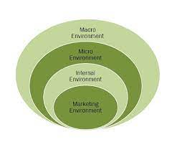
MARKETING ENVIRONMENT
The marketing environment refers to all internal and external factors, which directly or indirectly influence the organization's decisions related to marketing activities. Internal factors are within the control of an organization; whereas, external factors do not fall within its control.

Slide 28
FEATURES OF MARKETING ENVIRONMENT
Dynamic: We all know that nothing remains the same forever, and things change in the blink of an eye. The environment in which the company operates changes over time. There can be changes in trends, technology, laws, government policies and customer tastes.
Relative: The marketing environment is relative in nature. Also, it is distinct for each organization. You might have observed that there are some products that get good responses in a particular country while they fail in another. Do you know why this happens? This is because there is a change in the marketing environment.
Uncertain: The market is unpredictable, and so does the marketing environment. Even when the company closely and constantly keeps a watch on the market, it faces unexpected threats.
Complex: Interaction among different forces operating in the marketing environment makes it complex.

Slide 29
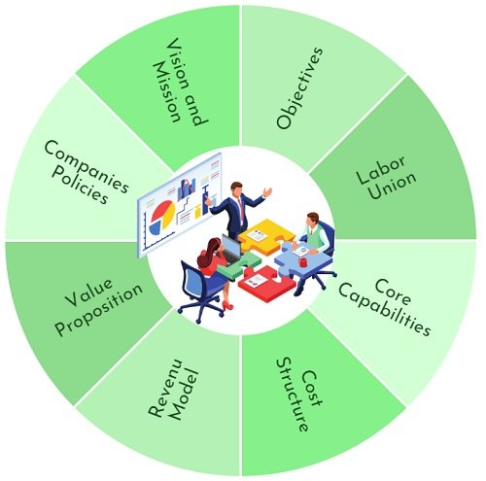
TYPES OF MARKETING ENVIRONMENT
1.Internal marketing environment: Marketing professionals work with the resources, company values, systems and processes that exist within a company. These influence the tasks that a company's marketing and advertising teams complete and how effectively they can create campaigns and content to be competitive in a market.These factors are within an organization
The factors are-

Slide 30
2.External Environment-It is concerned with everything that takes place outside the firm. The external environment of the firm has two further divisions:
a.Micro Environment
It includes all factors closely associated with the operations and influences its functioning.These factors are controllable to some extent. The factors are as follows….
Customers: Every business revolves around fulfilling the customer’s needs and wants. Thus, each marketing strategy is customer oriented. It focuses on understanding the need of the customers and offering the best product that fulfils their needs.
Employees: They are the lifeblood of a business. This is because they contribute significantly to its success. They are the ones who can make or break the company. Thus, Training & Development is crucial to impart marketing skills to an individual.

Slide 31
Suppliers: They are the party from whom the firm purchases material. Using the material, the firm produces finished goods. Hence, they are very important for the organization. It is pertinent to identify the suppliers existing in the market and choose the best that fulfils the firm’s requirements.
Channel partners/Intermediaries: Retailers and distributors are important to the success of marketing operations. As they are in touch with customers, they can give suggestions about customers’ demand for a product and its services. Also, they are the ones who remain updated about the increase or decrease in sales.
Competitors: We all know that competition leads to success. Keeping a close watch on competitors enables a company to design its marketing strategy accordingly.
Shareholders: They are the owners of the company. Every firm has an objective of maximizing its shareholder’s wealth. Thus, marketing activities should be undertaken keeping in mind the returns to shareholders.

Slide 32
b.Macro Environment It includes all those factors that exist outside the organization. Hence, they can not be controlled. These factors majorly include Social, Economic, Technological Forces, and Political and Legal Influences.
Political and Legal Factors: With the change in political parties, several changes are seen in the market. They can be in terms of trade, taxes, duties, codes and practices, market regulations, etc. So the firm has to follow all these changes. Further, the violation of this could penalize its business operations.
Economic Factors: Every business operates in the economy. Therefore, it is affected by the different phases it is undergoing. In the case of a recession, the marketing practices should be different from what is followed during the inflation period.

Slide 33
Social Factors: Since a business operates in a society and so, it has some responsibility. It must follow marketing practices that do not harm the sentiments of people. Also, companies must invest in the welfare of the general people. They can do so by constructing public conveniences and parks, sponsoring education, etc.
Technological Factors: Technology is everchanging. So, the firms have to keep themselves updated so customers’ needs can be met more precisely. The company can also integrate state-of-the-art technology in the production of goods. This will lead to a reduction in the cost

Slide 34
WHAT IS MARKETING MIX
The four Ps are the key considerations that must be thoughtfully reviewed and wisely implemented in order to successfully market a product or service. They are product, price, place, and promotion.
The four Ps are often referred to as the marketing mix. They encompass a range of factors that are considered when marketing a product, including what consumers want, how the product or service meets or fails to meet those wants, how the product or service is perceived in the world, how it stands out from the competition, and how the company that produces it interacts with its customers.

Slide 35


Slide 36
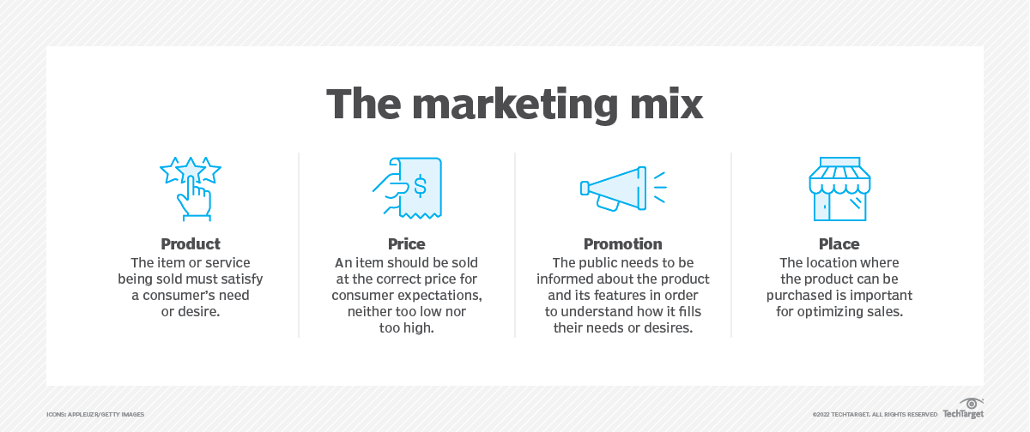

Slide 37
Product. The item or service being sold must satisfy a consumer's need or desire.
Price. An item should be sold at the right price for consumer expectations, neither too low nor too high.
Promotion. The public needs to be informed about the product and its features to understand how it fills their needs or desires.
Place. The location where the product can be purchased is important for optimizing sales.

Slide 38
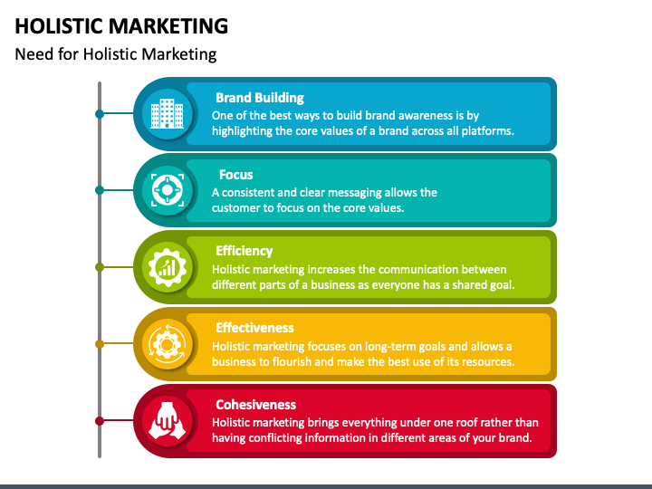
HOLISTIC MARKETING
Holistic marketing is a business marketing philosophy which considers business and all its parts as one single entity and gives a shared purpose to every activity and person related to that business.Holistic marketing concept enforces this interrelatedness and believes that a broad and integrated perspective is essential to attain best results.

Slide 39
This philosophy has the following features:
A Common Goal
Holistic marketing concept believes that the business and all its parts should focus towards one single goal which is a great customer experience.
Aligned Activities
All of the services, processes, communication and other business activities should be directed towards that common goal.
Integrated Activities
All activities should be designed and integrated in such a way so as to create a unified, consistent and seamless customer experience.

Slide 40
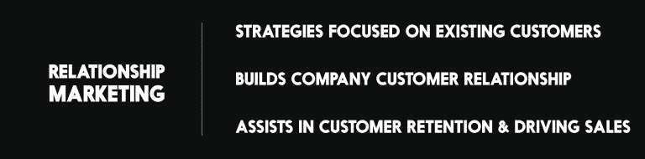
COMPONENTS OF HOLISTIC MARKETING
1.Relationship Marketing
The relationship marketing aspect of holistic marketing philosophy focuses on a long-term customer relationship and engagement rather than short-term goals like customer acquisition and individual sales. This strategy focuses on targeting marketing activities on existing customers to create a strong, emotional, and everlasting customer connections. These connections further help the business in getting repeated sales, free word of mouth marketing and more leads.

Slide 41
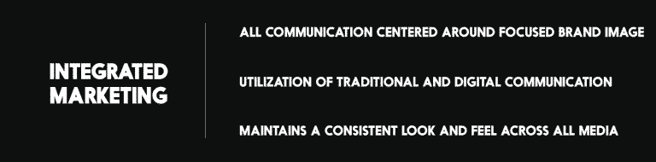
2.Integrated Marketing
Integrated marketing is an approach to create a unified and seamless experience for the consumer to interact with the brand by designing and directing all communication (advertising, sales promotion, direct marketing, public relations, and digital marketing) in such a way so that all work together as a unified force and centres around a strong and focused brand image.

Slide 42
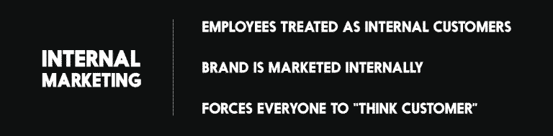
3.Internal Marketing-There are two types of customers to every business: internal and external. While focusing on external customers should be a top priority for every business, internal customers should not be left unnoticed as these internal customers (employees) play a vital role in marketing the brand and products to the external customers of the business.
Internal Marketing treats employees and staffs as internal customers who must be convinced of a company’s vision and worth just as aggressively as external customers. It also involves crafting processes which make them understand their role in the marketing process.

Slide 43
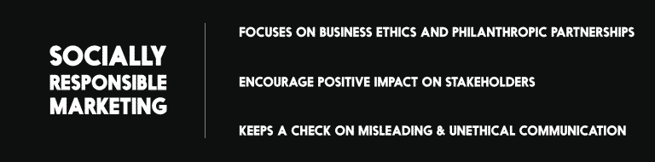
4.Socially responsible marketing
The socially responsible marketing aspect of the holistic marketing concept involves a broader concern of the society at large. It requires the business to follow certain business ethics and focuses on partnerships with philanthropic and community organisations. A business is considered as a part of the society and is required to repay the same.
Socially responsible marketing encourage a positive impact on company’s stakeholders.

Slide 44
One of the examples of a holistic approach you can take is of our body. Our Body is only strong when all our body parts work properly. Similarly, with a holistic approach, an organization only has the strong potential to achieve its marketing goals when its all components work together properly.
Coca-Cola’s Real Magic – Another good example of holistic marketing is the practice of the Coca-Cola Company. They are not promoting the brand only they are also sharing the happiness with the brand. They launched the “Real Magic” they said is about creating a movement to choose a more human way of doing things by embracing our unique perspectives.
Everything from how the products are developed with the customer in mind, to the stores being branded in a recognizable fashion, to the customer service being extremely quick, efficient, and polite, Apple could be considered a master in using this strategy.

Slide 45
CUSTOMER RELATIONSHIP MANAGEMENT(CRM)
Customer relationship management (CRM) is the combination of practices, strategies and technologies that companies use to manage and analyze customer interactions and data throughout the customer lifecycle.
The goal is to improve customer service relationships and assist in customer retention and drive sales growth. CRM systems compile customer data across different channels, or points of contact, between the customer and the company, which could include the company's website, telephone, live chat, direct mail, marketing materials and social networks. CRM systems can also give customer-facing staff members detailed information on customers' personal information, purchase history, buying preferences and concerns.
CRM software or technology is a tool or system of tools that help businesses aggregate, organize, and analyze customer information data to better manage relationships with customers.

Slide 46
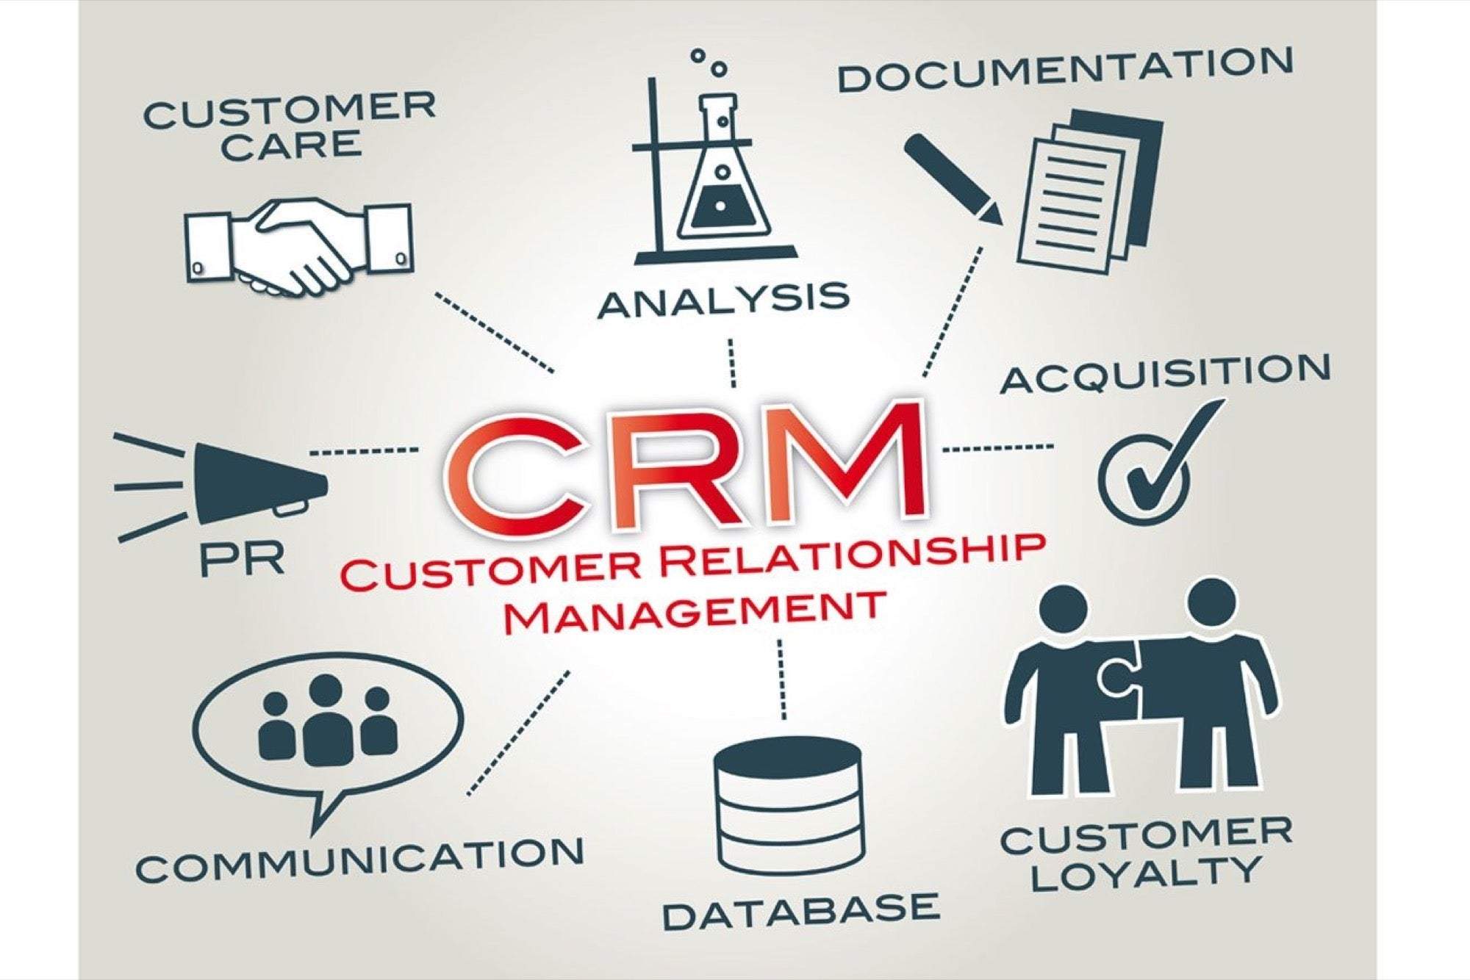
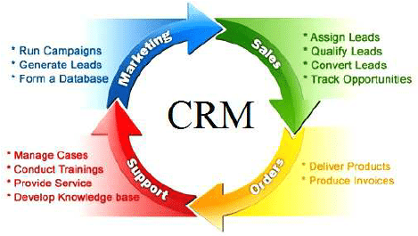

Slide 47
WHAT IS HRM?
Human resource management is the strategic and coherent approach to the effective and efficient management of people in a company or organization such that they help their business gain a competitive advantage. It is designed to maximize employee performance in service of an employer's strategic objectives.
Human: refers to the skilled workforce in an organization.
Resource: refers to limited availability or scarce.
Management: refers how to optimize and make best use of such limited or scarce resource so as to meet the organization goals and objectives.
Therefore, human resource management is meant for proper utilisation of available skilled workforce and also to make efficient use of existing human resource in the organisation

Slide 48
NATURE/CHARACTERISTICS/FEATURES OF HRM
Human Resource Management: Nature
Human Resource Management is a process of bringing people and organizations together so that the goals of each are met. The various features of HRM include:
It is pervasive in nature as it is present in all enterprises.
Its focus is on results rather than on rules.
It tries to help employees develop their potential fully.
It encourages employees to give their best to the organization.
It is all about people at work, both as individuals and groups.
It tries to put people on assigned jobs in order to produce good results.
It helps an organization meet its goals in the future by providing for competent and well-motivated employees.
It tries to build and maintain cordial relations between people working at various levels in the organization.
It is a multi-disciplinary activity, utilizing knowledge and inputs drawn from psychology, economics, etc.

Slide 49
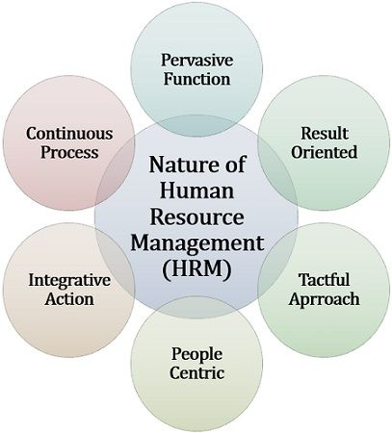

Slide 50
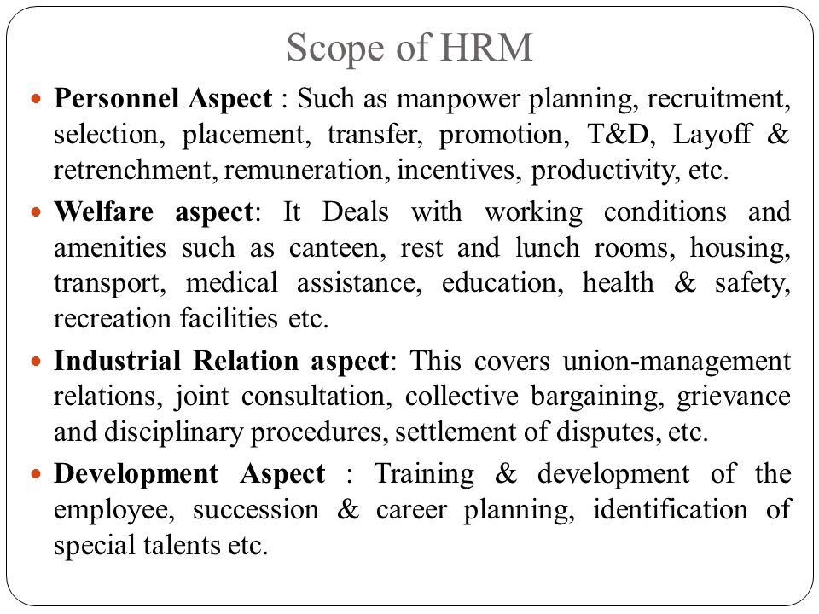
SCOPE OF HRM

Slide 51
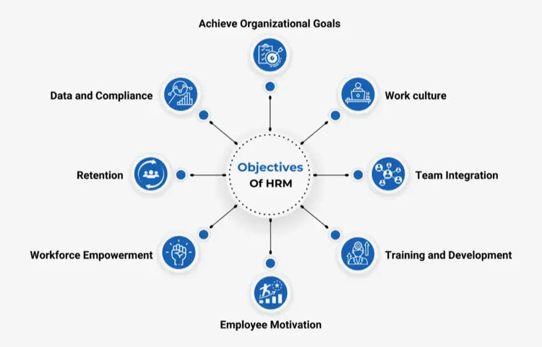
OBJECTIVES OF HRM
CONT….

Slide 52
Achieving organizational goals: Utilization of available resources to fulfill the goals of the organization
Work culture: Promoting and maintaining a work culture that empowers employees
Training: Conducting training sessions to create a purposeful and effective workforce
Team integration: Maintaining proper coordination between different teams or departments of the organization
Employee motivation: Motivating the workforce to utilize their potential for better results
Retention: Ensuring workforce retention for the smooth operation of the organization
Relationship: Promoting and strengthening the relationship between the organization and the employees

Slide 53
FUNCTIONS OF HRM
1.Planning of Human Resources-Proper planning of the available human resources is an essential part of the HRM job profile. Each organization has certain available human resources. It is the job of the HR managers to train and distribute the resources in a way that helps the organization reach its potential in the best way.
Furthermore, an HR manager needs to determine the goals and tasks the employees must fulfill while working for the organization. This way, they can also design an effective hiring process. Finally, the HRM also has to understand the requirements of individual departments regarding the candidates they are looking for. It is necessary as the needs of different departments could be drastically different from one another.
The HRM department makes sure that the company is not understaffed or overstaffed. Hence, they carefully consider the demand of each department.

Slide 54
2.Employee hiring and selection
hiring or recruitment is a primary function that HR manager has to fulfill. It is their responsibility to spot an efficient and qualified candidate who can help in achieving the objectives and goals of the organization as an employee. So, naturally, that all begins with hiring candidates from a list of suitable applicants.
The HR manager identifies suitable candidates for the organization and begins the selection process. The favorable candidates go through a comprehensive screening process which the HRM handles. This is done to ensure the potential candidate is a good fit for the company. Besides screening, the candidates also go through different rounds of interviews that test their skills and knowledge about the required position and then the candidate is selected if suitable for the job position.

Slide 55
3.Employee performance management
An HR manager's role is to ensuring proper employee performance management.It is to ensure that the employees meet the goals and objectives of the organization.
The performance management function of an HR manager involves certain things. Take a look:
Designing a proper job description
Initiating the selection process for suitable employees for a job position
Providing right training
Boosting the performance of the employees
Real-time feedback
Performance review
Designing proper appraisal and benefits

Slide 56
4.Employee Learning and Development The learning and development part can be considered one of the advisory functions of HRM. Learning and development is a continuous process that encourages the development of employees. As an HR manager, one needs to analyze the skill gaps existing within the organization. Furthermore, they must design training programs to empower employees to gain specific knowledge. The training programs should also have the capability of boosting the overall performance of the employees.
There are different ways of implementing learning and development. The HRM department can also help the employees by sharing insights and knowledge. It is also a part of the learning and development process to re-skill or up-skill the employees.

Slide 57
5. Labor relations-it is important to ensure that the employees collectively work toward the company's overall goal. Hence, it is the job of HR to spot the communication gaps between two employees or an employee and the organization. It is risky to keep those events unattended as that may lead to conflict and chaos within the organization. Also, the HRM needs to create policies that are fair and transparent.
6.Succession Planning-It is one of the core functions of the human resources department. Under this function, the department plans, monitors, and manages the growth of employees from within the organization. This is carried out to track promising employees who can contribute more to the organization. With the help of the data collected by the HRM department, employees get the chance to succeed in their careers as the organization considers it profitable to invest in their development.

Slide 58
ROLE OF AN HR MANAGER
1. Human Resource Planning -Hr manager has to ensure an organization has the right number of employees with the necessary skills to meet its goals. This involves forecasting future staffing needs and ensuring that the recruitment and training programs can meet these needs.
2. Hiring Candidates- Finding and hiring the right talent is a very complex process. Modern HR departments do more than post job requirements in portals to fill open positions. They develop strategic solutions to attract suitable candidates to fulfill the demands of the business.
An HR manager might also be responsible for a company’s employer brand reputation—or guiding the branding strategy. Employer branding is critical to communicating a company’s culture and work-life balance to potential employees.

Slide 59
3. Design Workplace Policies- HR manager roles and responsibilities include designing workplace policies to reduce conflicts and legal issues and improve employee productivity. These policies are designed to protect the interests of both employees and employers alike.
Though workplace policies differ from organization to organization, the things it includes remain the same in every company, such as –
Standard operating procedures
Anti-harassment and non-discrimination
Paid leaves, sick leaves, and time-off benefits
Meal and break periods
Time tracking
Employee attendance and punctuality

Slide 60
4.Performance Management
General human resources manager roles and responsibilities are closely related to training, including examining employee performance records to identify the scopes of improvement and arranging training workshops to upskill them.
93% of employees say professional growth is a priority. You can create a positive environment and boost employee loyalty by allowing employees to learn something new and grow professionally.
Besides, improving your employees’ skills brings additional benefits to the organization.
First, they feel they are a vital part of the company
Second, due to increased job satisfaction, they will give their best in each task

Slide 61
5.Resolve Conflict- In every organization, employees come from diverse backgrounds. And when people with opposite opinions meet, the chances of conflict rise significantly. Whether the issue is between two employees or an employee and the management, the human resources management has to mediate conflict resolution.
6.Rewards and Incentives-HR managers must reward employees based on their performance and other factors like punctuality. The biggest benefit of rewarding workers is that it creates a desire for other employees to excel at their job in the hope of getting incentives. Additionally, you can consider giving the power to employees to choose the type of reward they want. For example, let them decide whether they want a bonus, flexible work times, leave, etc. It will make them feel valued, increase job satisfaction, and boost productivity.
You can also involve organizational stakeholders to decide on the rewards and incentives they’d like to give individual employees based on their performance.

Slide 62
HUMAN RESOURCE PLANNING
Human resource planning identifies the present and foreseeable demands of human resources that an organization will require to reach its objectives. It aims to act as a link between human resource management and an organization’s overarching strategic plan.
Human resource planning concept is a tactic businesses use to keep a regular flow of qualified workers while preventing staff surpluses or shortages.
A company’s productivity and profitability can increase with a robust plan.
Human resource planning is a process that identifies current and future human resources needs for an organization to achieve its goals. Human resource planning should serve as a link between human resource management and the overall strategic plan of an organization.

Slide 63
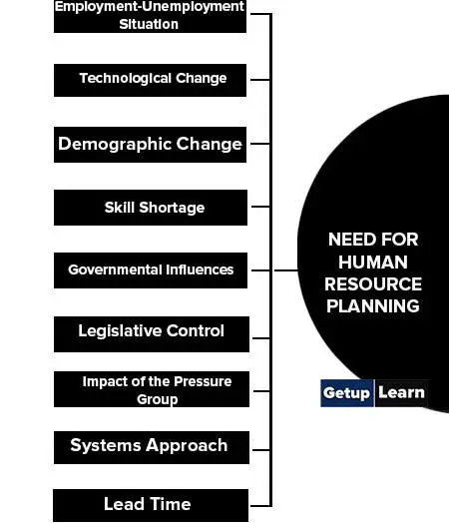

NEED OF HUMAN RESOURCE PLANNING

Slide 64
Employment-Unemployment Situation- Though in general, the number of educated unemployed is on the rise, there is an acute shortage of a variety of skills. This emphasizes the need for more effective recruitment and employee retention.
Technological Change -The changes in production technologies, marketing methods, and management techniques have been extensive and rapid. Their effect has been profound on the job contents and job contexts. These changes have caused problems relating to redundancies, retention, and redeployment. All these suggest the need to plan manpower needs intensively and systematically.
Demographic Change-The changing profile of the workforce in terms of age, sex, literacy, technical inputs, and social background has implications for HRP.
Skill Shortage-Unemployment does not mean that the labor market is a buyer’s market. Organizations generally become more complex and require a wide range of specialist skills that are rare and scarce. A problem arises in an organization when employees with such specialized skills leave.

Slide 65
Governmental Influences-Government control and changes in legislation with regard to affirmative action for disadvantaged groups, working conditions and hours of work, restrictions on women and child employment, casual and contract labor, etc. have stimulated the organizations to become involved in systematic HRP.
Legislative Control-The policies of “hire and fire” have gone. Now the legislation makes it difficult to reduce the size of an organization quickly and cheaply. It is easy to increase but difficult to shed the fat in terms of the numbers employed because of recent changes in labor law relating to layoffs and closures. Those responsible for managing manpower must look far ahead and thus attempt to foresee manpower problems.
Impact of the Pressure Group- Pressure groups such as unions, politicians, and persons displaced from land by the location of giant enterprises have been raising contradictory pressure on enterprise management such as internal recruitment and promotion, preference for employees’ children, displaced person, sons of the soil, etc.
Systems Approach-The spread of system thinking and the advent of the macro computer as part of the ongoing revolution in information technology which emphasizes planning and newer ways of handling voluminous personnel records.
Lead Time-The long lead time is necessary for the selection process and training and deployment of the employee to handle new knowledge and skills successfully.

Slide 66
PROCESS OF HRP
Forecasting the organization’s demand for and supply of human resources is done through the planning process.
Choosing the Goals: Determining the goals for which the process will be carried out is the first step in every cycle. For example, to choose the correct number of people for the right job, it is essential to identify the goal for which workforce planning is to be done.
Examine the present personnel supply: use the data saved about the staff’s expertise, competency, abilities, etc., to carry out a specific job. Additionally, it is possible to predict future openings to plan for the workforce from internal (inside the current employees) and external (hiring applicants from outside) sources. I
Estimating Demand and Supply: After maintaining an inventory of skilled employees, the next stage is to match anticipated future demand for employees with the organization’s current supply of resources.
Action plan: Once the staffing shortfalls have been assessed, an employment or action plan should be created. If there is a shortfall, the company may pursue recruitment, training, or interdepartmental transfer plans; if there is a surplus, the company may pursue voluntary retirement plans, redeployment, transfer, or layoffs.
Training and Development: Training is provided for both current personnel and new hires, as both groups must periodically upgrade their skill sets
Example-Suppose a garments firm ABC Ltd needs help with the supply of staff. First, it will analyze the organization’s goals and departmental needs. After this, it will examine the collection available to the organization and plan to fill the vacant positions. Continuous training is the last but not minor step of this process. Timely feedback from management and employees ensures the effectiveness of the staffing position.

Slide 67
HUMAN RESOURCE POLICIES
HR policies are an essential framework that every company needs to ensure smooth functioning. These policies are the guiding factor that tells the company and the employees how to work and conduct themselves to ensure a safe and secure working environment for all.
HR policies are also described as the set of concepts and norms of behaviour that regulate an organisation’s interaction with its workers. A policy proposal of this type sets instructions for a broad range of employment connections inside the business. The aim and relevance of HR rules are self-evident. Every firm needs policies in order to promote regularity in behaviour and equality in employee relations.

Slide 68
HR POLICIES ARE AS FOLLOWS:-
1.Employment contract-In India, it is crucial to file proper documentation of the employees that work in the company. The employee contract acts as the umbrella covering a list of HR policies and agreements.
As per India’s employment laws, it is essential to file proper documentation of the employees to ensure appropriate navigation through the complex and diverse employment framework.
Therefore, having accurate and updated documents that prove the employee’s compliance to the company will help in the long term and save them from any legal hassles later. Therefore, you need to follow the labour and wage laws while processing documentation.
2. Employee wages-Employee payroll is one of the significant aspects of employee management. The job of the HR department of the company is to manage the employee payroll effectively. This includes offering competitive salaries to employees and staying in compliance with the government policies.

Slide 69
3. Code of Conduct-The Code of Conduct is the company’s policies, consisting of its vision, mission, and ethics. This is created to inform employees about the policies of the behaviour and maintain discipline while at the workplace.
The code of conduct is among the types of HR policies containing the company’s rules that employees need to adhere to. The policy includes dress code, equal rights to all, electronic usage policy, conflict of interest, media policy, proper work environment etc. It also contains the rules and penalties if an employee breaches or violates the code of conduct.
4. Leave policy-As per requirement, every company should have a good leave policy to provide a clear picture of the leaves they would be entitled to take in a year. The policy should include a proper bifurcation of the leaves into paid leaves, sick leaves or casual leaves etc. It must also mention public holidays.

Slide 70
5. Employee provident fund- Every employer is liable to set up an employees provident fund account for each of its employees. The Employees Provident Fund Act, 1947 provides income security to the employees after their retirement. This is more like a security fund offering various benefits for employees, such as housing care, medical insurance and retirement pension.
It is important to note that companies exceeding 10 employees must provide provident fund benefits to their employees. Therefore, if you have more than 10 employees, then you are liable to have a provident fund scheme for your employees.
6. Gratuity Policy- The gratuity policy is a way for companies to appreciate the services provided by their employees towards the company. The gratuity policy applies to all employees who have provided more than 5 years of continuous service to the organisation.
The company is liable to pay a one-time payment as gratuity payout to employees who are either being laid off or resigning, but have provided 5 years or more of continuous service. This is vital to keeping employees happy and engaged. Moreover, companies are legally bound, as per The Payment of Gratuity Act, 1972, to pay gratuity to their employees.

Slide 71
CHANGING ROLE OF HUMAN RESOURCE IN INDIA
The role of Human Resources (HR) in India has been evolving over the years due to various factors such as globalization, technology advancements, and changing workplace dynamics. Here are some key changes in the role of HR in India:
1. Strategic Partner: HR has shifted from being primarily administrative to becoming a strategic partner in organizations. HR professionals are now involved in decision-making processes, aligning HR strategies with business objectives, and contributing to overall organizational growth.
2. Talent Management: There is a greater focus on talent acquisition, retention, and development. HR in India plays a crucial role in attracting and retaining top talent, as well as ensuring their continuous learning and growth within the company.
3. Diversity and Inclusion: HR is actively promoting diversity and inclusion in the workplace. Companies in India are recognizing the importance of having a diverse workforce and are implementing policies and practices to create inclusive environments.
4. Technology Integration:HR is leveraging technology for various functions, including recruitment, payroll, performance management, and employee engagement. This has led to the rise of HR tech solutions and the need for HR professionals to be tech-savvy.

Slide 72
5. Employee Well-being:The pandemic highlighted the importance of employee well-being. HR departments in India are focusing on mental health initiatives, flexible work arrangements, and employee support programs to ensure the well-being of their workforce.
6. Compliance and Regulations: HR in India is continuously adapting to changes in labor laws and compliance requirements. Staying updated with legal regulations is crucial to ensure fair and ethical workplace practices.
7. Remote Work:The adoption of remote work has become more widespread, and HR is tasked with managing remote teams, ensuring productivity, and addressing the challenges associated with remote work.
8. Data-Driven Decision Making: HR is increasingly relying on data analytics to make informed decisions related to talent management, performance evaluation, and workforce planning.

Slide 73
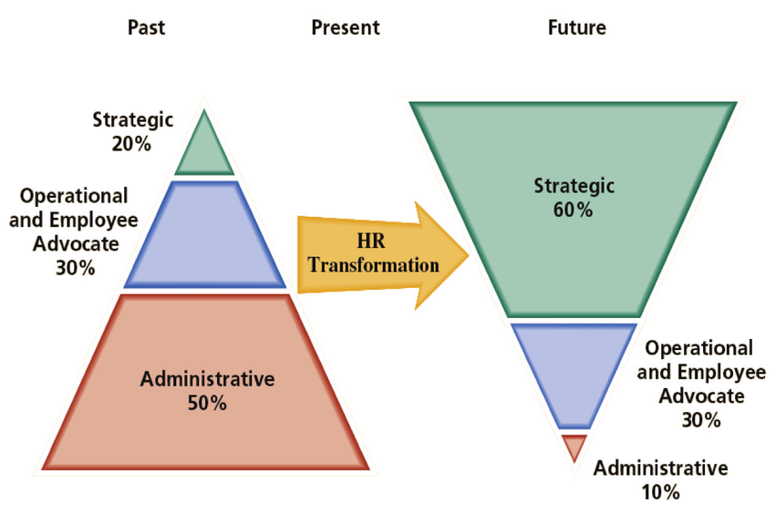
Traditionally the Human Resource Management function dealt with or provided leadership and advice to deal with all employee centric issues in an organisation. It dealt with employee onboarding, recruitment, remuneration, organisational development, performance management, safety, succession planning, and wellness of employees, communication, administration, training, and maintaining the motivational level of employees. It also strategically managed people and the workplace environment and culture. Trends that are changing the HRM function enabled the employees to effectively and productively contribute towards the overall direction of the company and the accomplishment of the goals and objectives of the organisation. With the changing times, the focus of HRM is also changing. HRM is slowly moving away from the traditional administration, personnel, and transactional roles as these are either outsourced or fully automated with exception based business rules. The function is now expected to perform value added tasks by strategically utilising employees and ensuring that the various employee programs are recommended and implemented in a positive manner which impacts the business in measurable ways.

Slide 74

GLOBALIZATION AND ITS IMPACT ON HUMAN RESOURCE

Slide 75


Slide 76
Globalization has had a significant impact on the field of Human Resources (HR) in several ways:
1. Diverse Workforce: Globalization has led to more diverse workforces. Companies now employ individuals from various cultural backgrounds, requiring HR to manage diversity and promote inclusion.
2. Talent Acquisition: With globalization, organizations have expanded their talent pool. HR has to adapt to recruit and retain talent from different parts of the world, often requiring an understanding of international labor laws and regulations.
3. Cultural Sensitivity:HR professionals need to be culturally sensitive and aware of the nuances of working with employees from different cultures. This includes understanding different work ethics, communication styles, and values.
4. International Assignments: Global companies often send employees on international assignments. HR is responsible for managing the logistics, ensuring legal compliance, and providing support for expatriates.
5. Remote Work: Globalization has also facilitated remote work, allowing companies to hire talent globally. HR must adapt to managing remote teams, including issues related to communication, time zones, and work-life balance.
6. Compliance and Regulations: Different countries have varying labor laws and regulations. HR must navigate these complexities to ensure that the company is compliant with local laws and global standards.
7. Training and Development: Globalization has increased the need for cross-cultural training and development programs. HR is responsible for providing training

Slide 77
Impact of globalization on human resource development is the necessity to consider cultural differences, both in and out of the workplace. Businesses tend to have their own corporate cultures or ways of operating, but there are societal and cultural differences between people as well.
Cultural norms within a society affect the workforce and how workers view their jobs, especially in relation to time spent with their family and ideas about employment expectations. Some cultures may also have varying mores about gender roles, particularly concerning the role of women in leadership. While a female in a managerial position is not uncommon in American culture, the same many not hold true elsewhere.
Global expansion is also affected by varying tax and labor laws. HR departments need to be prepared to deal with different tax rates, benefit requirements or labor and environmental regulations. These requirements may be in addition to or even in conflict with current corporate policies, so adjustments to maintain compliance with local governments are necessary
IMPACT OF GLOBALIZATION ON HRM Managing Cultural Diversity, Managing Expatriates , Difference in the Employment Laws, Managing Outsourcing of employees , Managing virtual employees , Corporate Social Responsibility, Coping with flexible working hour, Evolution of more part-time and temporary work(especially among women, the elderly and students). Coping up with emerging technologies & quality measured, Changing perspective from subordinates to business partners.

Slide 78
THANK YOU

